Slide 1
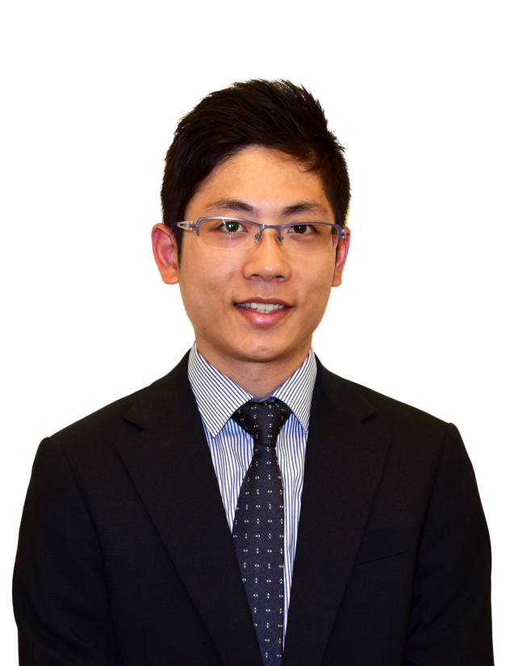
消費即賺與一站式網上購物平台 Getting Paid to Shop Smart
One Stop Online Shopping Platform
Chris Wong
高級業務拓展主任 Senior Business Development Executive

Slide 2
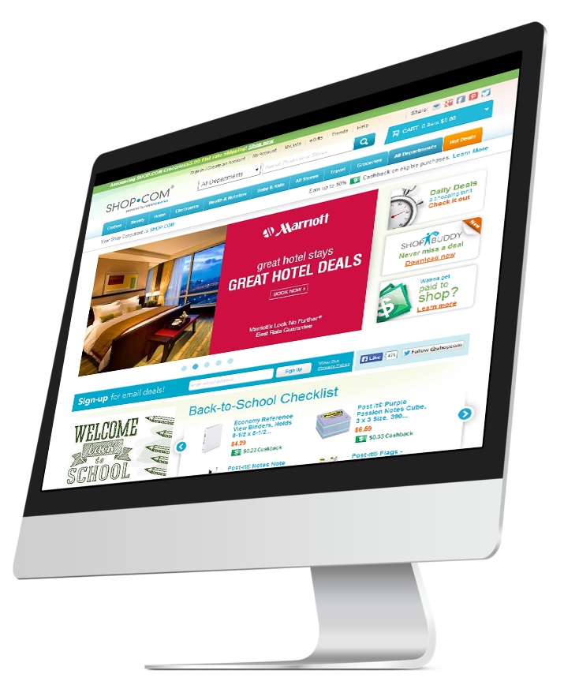
消費即賺 Getting Paid to Shop Smart
一站式網上購物平台
One stop online shopping platform

Slide 3
獨家代理品牌產品
2% 現金回贈
2% Cashback

Slide 4
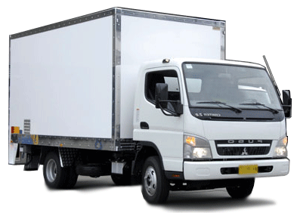
推廣優惠券
Coupons
自動送貨
高達10%折扣
Up to 10% off
高達10%折扣
Up to 10% off
10%Discount

Slide 5
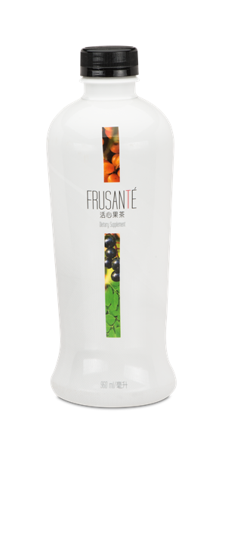
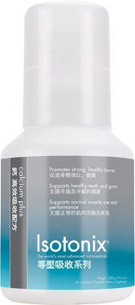
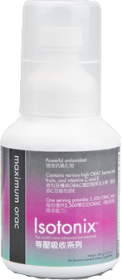
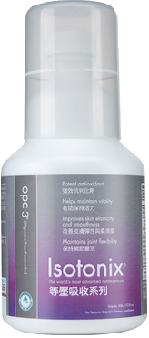
例子Example
購買$2,000產品
Purchase of $2,000
最高折扣: $2,000 x 10% = $200
Max. discount:
現金回贈: $1,800 x 2% = $ 36
Cashback
折省總額: $236
Total save amount:

Slide 6
購物
$1, 00
1
5
$ 0
基本運費
4
3
0
5
2
免費送貨 ShipFree *
*部份偏遠地區除外
*Except designated remote areas

Slide 7
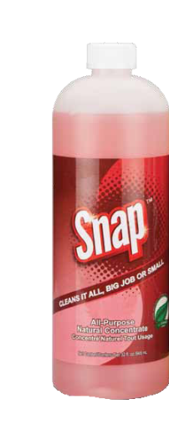
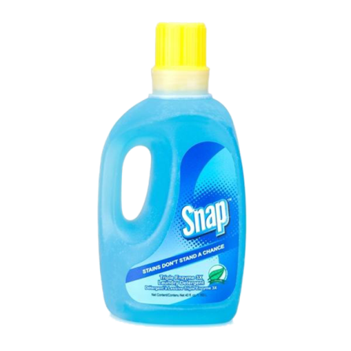
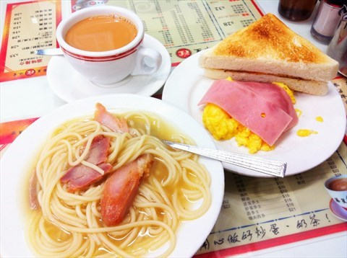
例子Example
購買$2,000產品
Purchase of $2,000
+ x 13
+ + $45
最高折扣: $2,000 x 10% = $200
Max. discount
早餐$22
免費送貨: $ 50
ShipFree
現金回贈: $1,800 x 2% = $ 36
Cashback
$122 + $119
折省總額: $236
Total save amount
$286

Slide 8
使用現金回贈
To use my Cashback

Slide 9
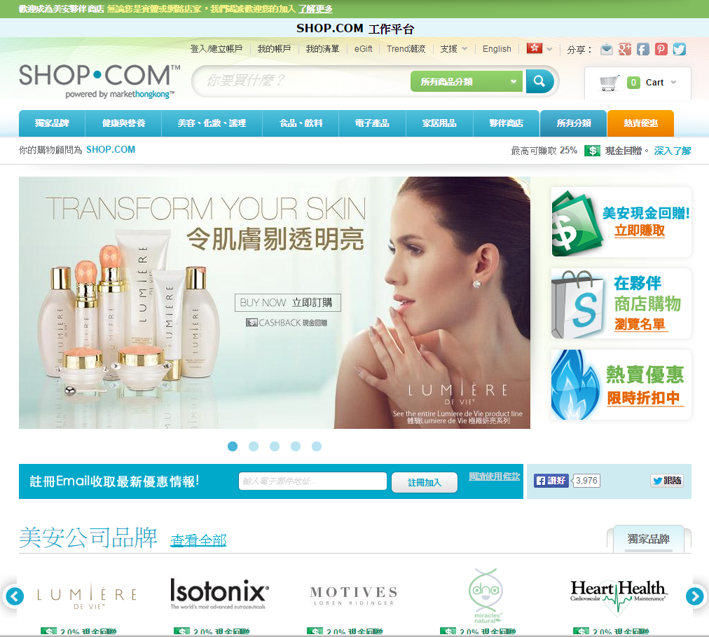
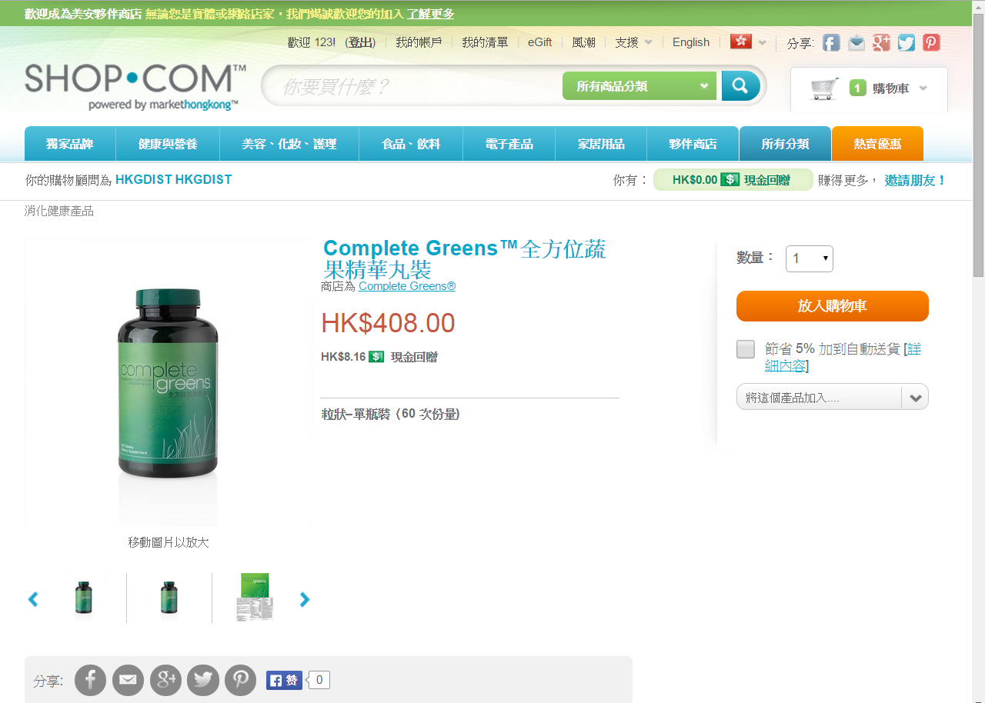

Slide 10
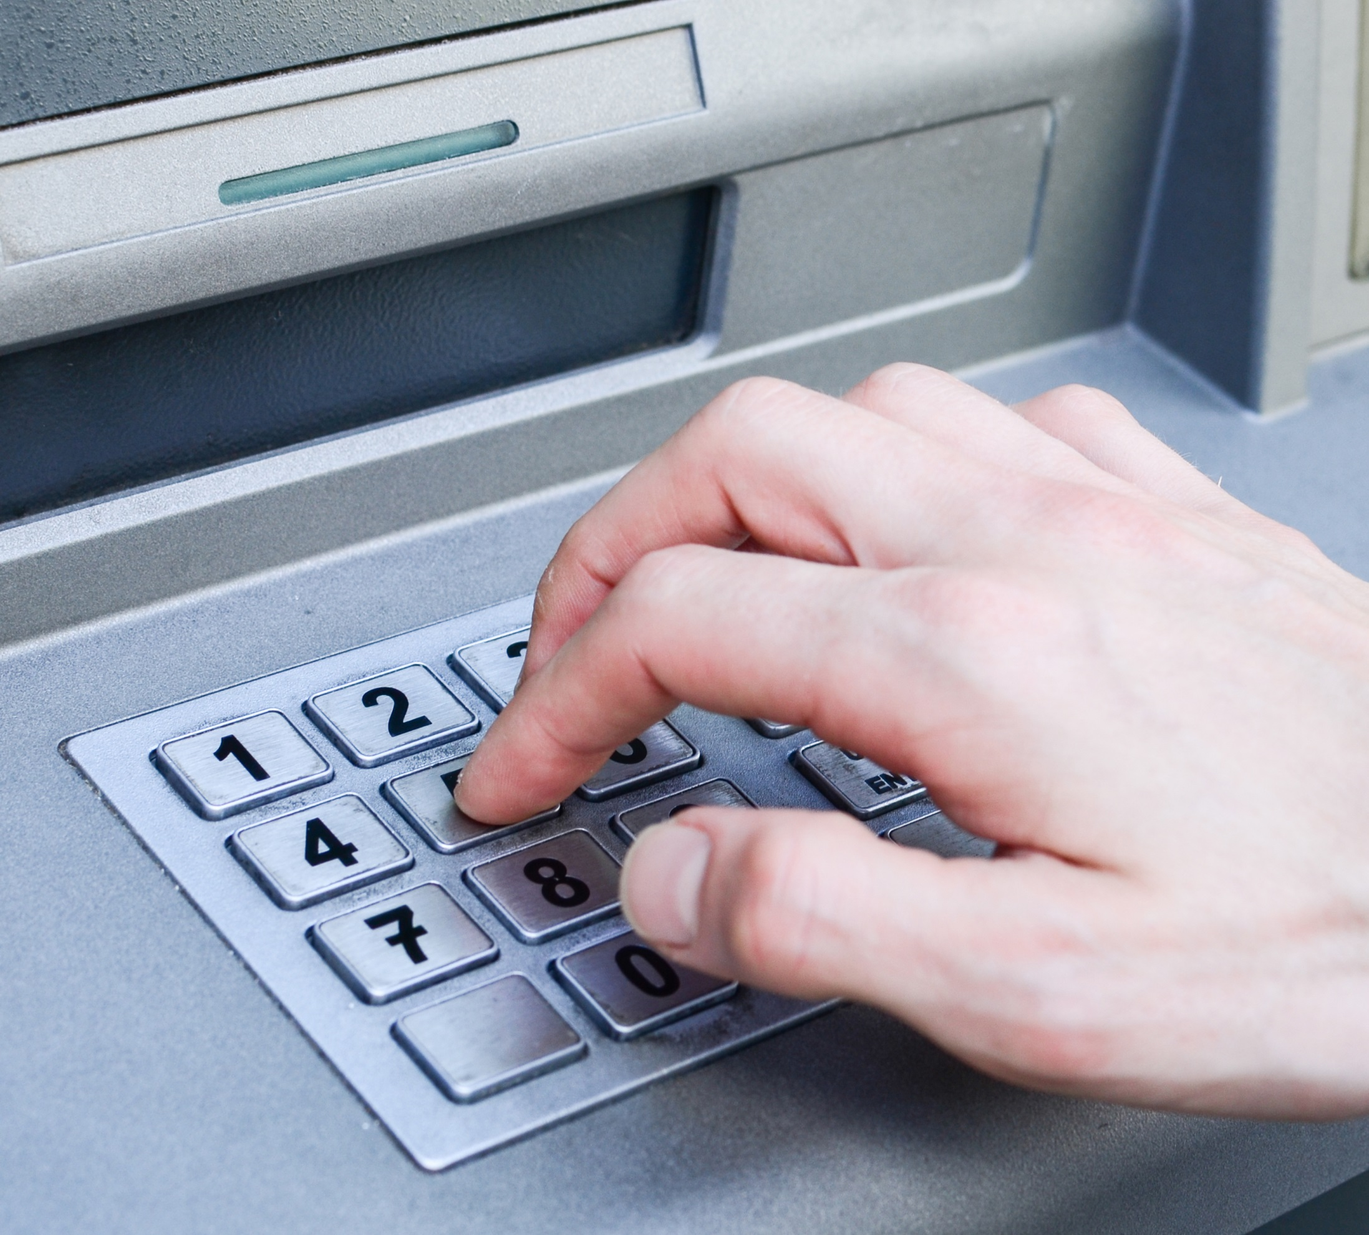
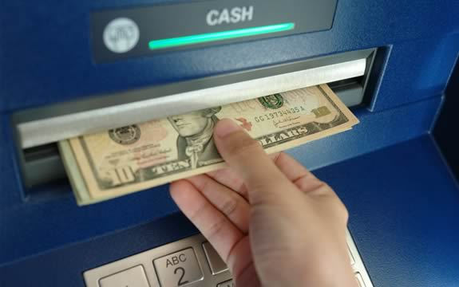

Slide 11
提供多於 Provided more than
港幣3千8百萬
38 million

Slide 12
現金回贈計劃更具彈性！
The Cashback program
is flexible!

Slide 13
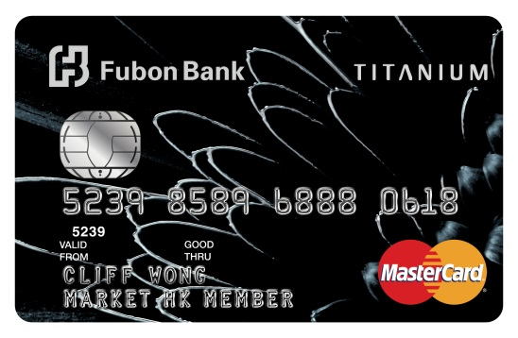
賺取積分換
取美安獨家產品及IBV
Earn points
to redeem mhk products and IBV
信用卡消費
Transaction paid by credit card
八達通卡自動增值
Octopus Card automatic value adding service with credit card
美安香港會員專享 -
富邦銀行鈦金卡
Exclusive offer to mhk members –
Fubon Titanium Credit Card
全球只有美安香港能做到！
Exclusive for Market Hong Kong only!
在日常生活中每一項消費，都可賺取IBV
Earns IBV for all daily transactions

Slide 14
在HK.SHOP.COM
你可以得到更多！
You can get more at HK.SHOP.COM

Slide 15
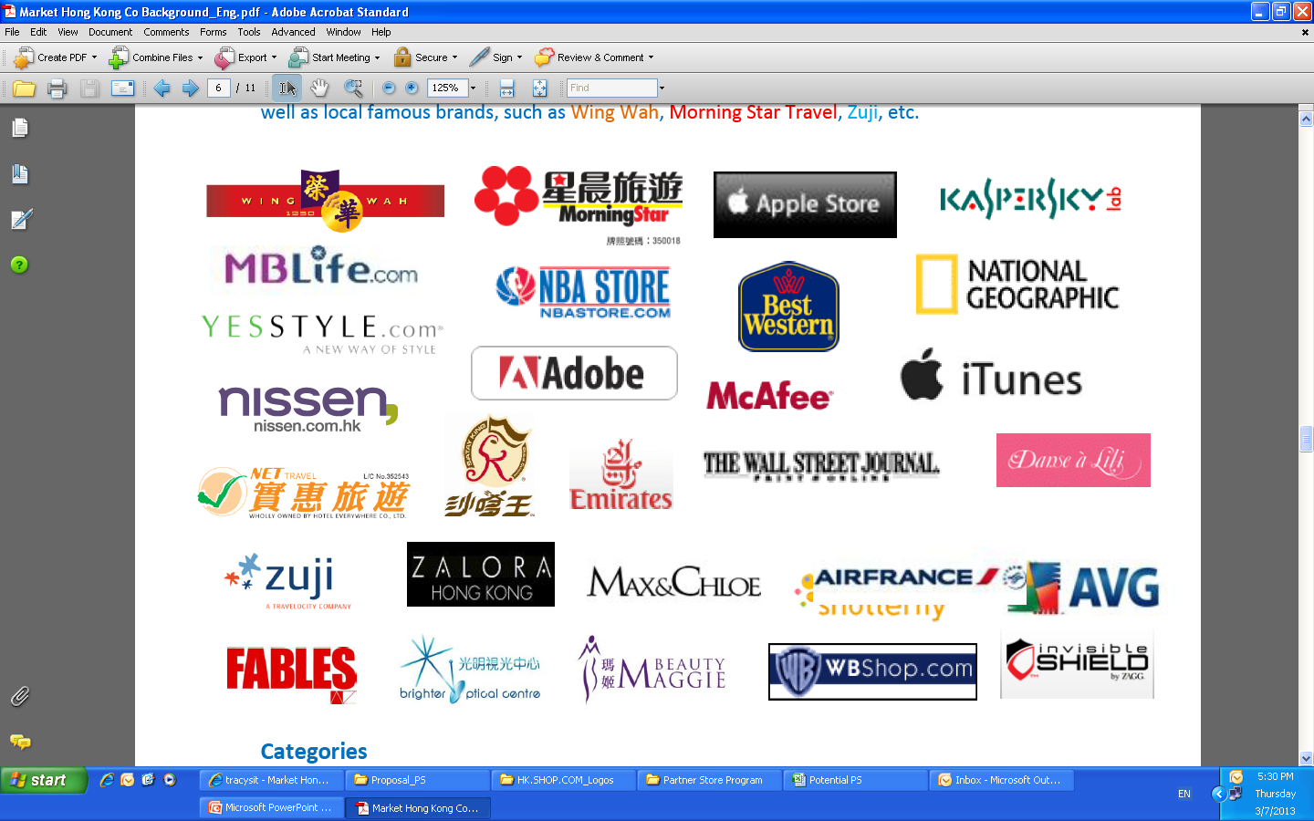
1300間夥伴商店提供 2%-25%現金回贈
1,300 Partner stores providing 2%-25% Cashback

Slide 16
賺取2%-25%現金回贈
Earn 2%-25% Cashback
你及你的顧客可進入超過1,300間夥伴商店消費
You and your customers gain access to over 1,300 stores

Slide 17
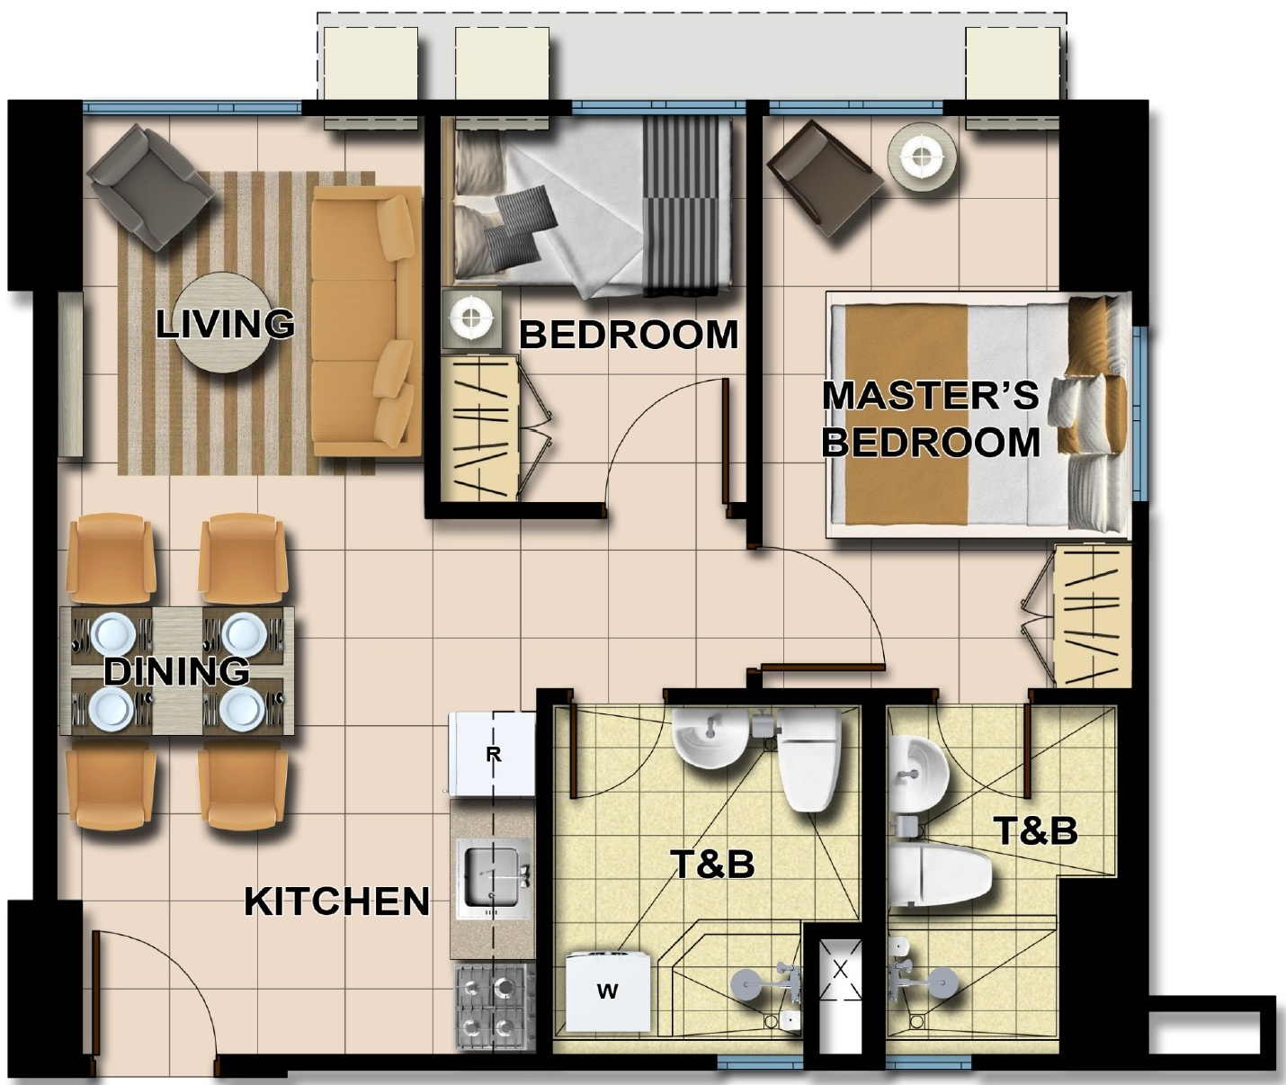
為每一項消費節省開支 Save money for every expense

Slide 18
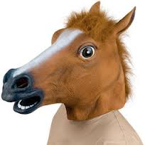
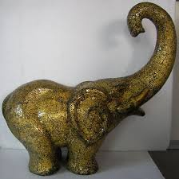
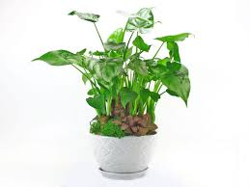
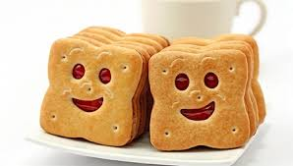
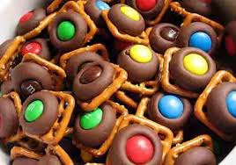
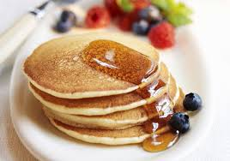
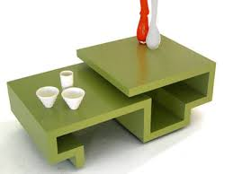
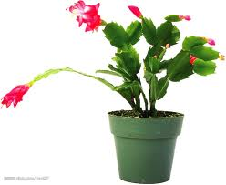
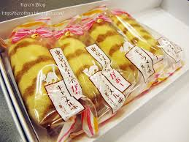
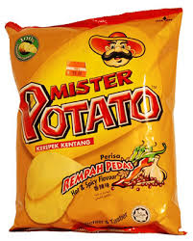
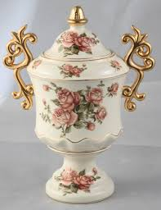
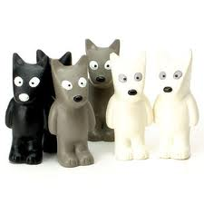
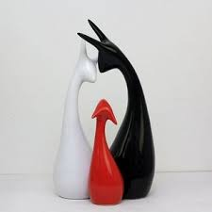
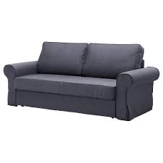
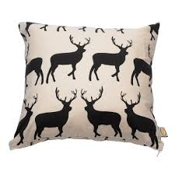

Slide 19
為每一項消費節省開支 Save money for every expense

Slide 20
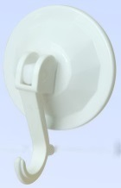
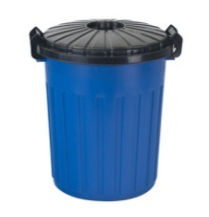
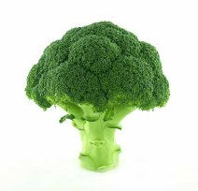
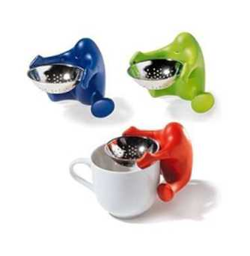
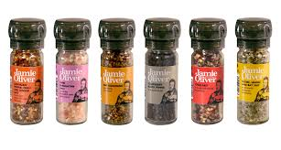
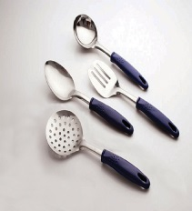
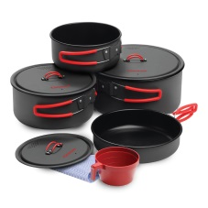
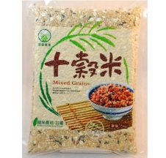
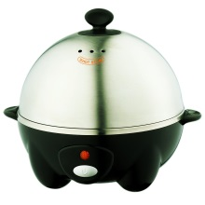
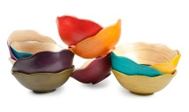
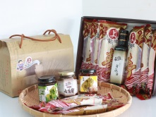
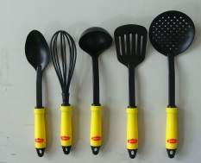
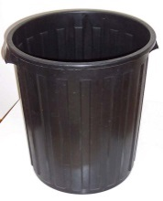
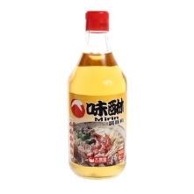
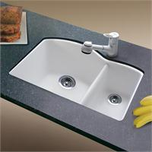
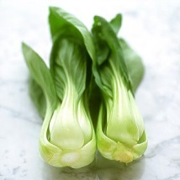
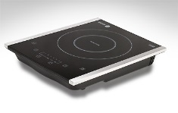
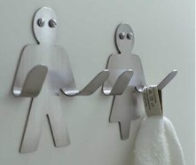

Slide 21
推薦新優惠顧客，額外賺取每次消費0.5%現金回贈
Refer new Preferred Customer, you can earn 0.5% Cashback of each qualified transaction

Slide 22
每月購物$5,000
Monthly expenses $5,000
2% ，優惠顧客自己即可得$100
PC can get $100
0.5% ， 推薦人即可得
Referrer can get $25
$5,000 x 0.5% = $25
如果一個月購物$3,500
2%現金回贈，自己即可得$70
推薦人可得$3,500x0.5% = $17.5

Slide 23
如果我是推薦人，$25現金回贈就是我的！
If I am the referrer, $25 Cashback is mine!
如果我推薦10個優惠顧客，我可以每個月有額外$250
If I refer 10 PCs, I can get $250 bonus Cashback every month

Slide 24
成為超連鎖™店主，你可以得到更多！
To be UFO, you can get even more!

Slide 25
夥伴商店提供日常衣食住行所需
Partner stores provide everything we needed for daily life
令自己消費同時累積IBV，賺取收入
Makes our daily expenses contributing IBV which helps to earn
好處1. 你以個人優惠顧客身份購物，你亦可獲得IBV及現金回贈
Advantage 1: You can earn both IBV & Cashback when purchase as a Preferred Customer
好處2. 你的優惠顧客購物，你可獲得點數
Advantage 2: You will be awarded BV/IBV when your PCs buy

Slide 27
HK$1,790
$53.7 4.59 IBV
HK$780
$15.6 3 IBV
HK$730
$36.5 2.8 IBV
HK$188
$7.5 0.48 IBV
HK$1,288
$25.7 4.95 IBV
HK$383
$15.3 0.98 IBV

Slide 30
售賣台灣食品食材，著重健康與口味
Provides Taiwanese food which is healthy and tasty

Slide 31
Q: 幾時加入美安香港
Q: 為什么當初加入美安香港成為夥伴商店
Q: 加入時商店怎樣，現在怎樣
Q: 美安優惠顧客返回購物的情況多嗎
Q: 你覺得這個平台怎樣
Q: 這個平台是否為你公司帶來更好的業績

Slide 32
現場熱賣
消費滿$100，贈送GARDEN CAFE白咖啡一盒，價值$35
或消費滿$250，贈送GARDEN CAFE白咖啡一盒 + 關廟麵一包，價值$77
指定貨品：
牛蒡酵素、有機糙米醋、梅酒、檸檬酒、荔枝酒、苦茶油
消費滿HK$100
指定貨品
送GARDEN CAFE白咖啡
買二送一

Slide 33
夥伴商店會議
美安生活廊
2014年11月26日
下午3-4點
Partner Store Conference
mhk Showcase
Nov 26, 2014
3:00pm – 4:00pm

Slide 34
夥伴商店巡禮
場外優惠

Slide 36
Sponsored gifts - perfume
贊助禮品-香水

Slide 37
Coming soon 即將發售
Christmas & new year travel package
聖誕及新年旅行套票
Lunar New Year travel package
農曆新年旅行套票

Slide 38
購物年金獎賞庫計劃
Shopping Annuity Bonus Pool

Slide 39
取代IBV宣傳獎賞庫
Replace the IBV Bonus Pool
激勵創造自己的購物年金，並同時幫助組織內的夥伴達標
Encourage to create own Shopping Annuity and help partners to achieve the same

Slide 40
每季送出高達二千萬的BV點數與一千萬的IBV點數
More than 20million BV and 10million IBV to be awarded quarterly

Slide 41
4個簡單步驟
4 simple steps
如何達成？
How to achieve?

Slide 43
達到各項要求，可享額外BV及IBV獎勵
Achieve all requirements
to get extra BV & IBV

Slide 44
季度期間，
完成「購物年金評量表」（即將推出）
購滿1,500 BV美安香港產品
在夥伴商店購物累計達HK$23,000.00
During the SABP season,
Complete the Shopping Annuity Assessment. (Coming soon.)
Order at least 1,500 BV worth of mhk products
Accumulate at least HK$23,000.00 in Partner Store orders

Slide 45
親自推薦的任何一位超連鎖™店主也同樣合格時，即可另外獲得50 BV與25 IBV。
Be awarded 50 BV and 25 IBV for every one of their personally sponsored UFOs who qualify for the SABP.
在一個商業發展中心的兩邊組織，各有10名同樣也符合獎賞庫計劃資格的超連鎖™店主時，此商業發展中心將可於接下來的12週中，在IBV管理業績紅利計劃下額外賺取 HK$4,600.00管理獎金。
Be eligible to earn the new HK$4,600.00 Management Bonus in the IBV Management Performance Compensation Plan (MPCP) during the next 12 weeks on each Business Development Center (BDC) with 10 UFOs who qualify for the SABP in its left organization and 10 who qualify in its right organization.

Slide 46
馬上行動！
Action now!
你還在等甚麼？
What are you waiting for?

Slide 47
全新HK.SHOP.COM
New HK.SHOP.COM

Slide 48
全新的網站介面、全新的功能、更易學易懂的操作及更豐富的美安香港獨家品牌資訊
New portal interface, functions, user friendly operation and more detailed information of mhk products

Slide 49
通訊錄Address Book
聯絡人
Contact list
eGift
我的清單
My Lists
禮品卡
Gift Cards
產品評論
Product Review
獨家產品
市場比較
Product comparison
Trend潮流
Trends
價格追蹤
Price Alert
SHOPBOX

Slide 50
網站更新：
eGifts
Trends 潮流
禮品卡
HK$100, HK$300, HK$500, HK$800, HK$1,000
家居顧問
Price Alert

Slide 51
eGift

Slide 52
1
2
3

Slide 54
Trend潮流

Slide 57
Gift Card 禮品卡

Slide 59
SHOPBOX

Slide 64
由美安香港提供
由美安香港提供
由美安香港提供

